Slide 1
Unit 23
Systems Methodology
(Paul Triandafilou)

Slide 2
Unit 23
Systems Methodology
Unit in brief
Learners investigate systems methodology and its uses in systems development and problem solving.
They will use systems methodology, tools and techniques to solve a problem.
This unit will prepare learners with the knowledge, confidence and skills needed for a systems analyst or systems engineer.

Slide 3
Unit 23 Systems Methodology
Systems methodology is used in software development to structure the development stages.
It helps to formulate and structure thinking about a problem scenario by providing an action-oriented process of inquiry
You will undertake research into the principles of systems methodology, along with the tools and techniques used to solve a complex problem.
You will select and apply systems methodologies to solve a problem
You will then reflect on your systems methodology skills and performance.

Slide 4
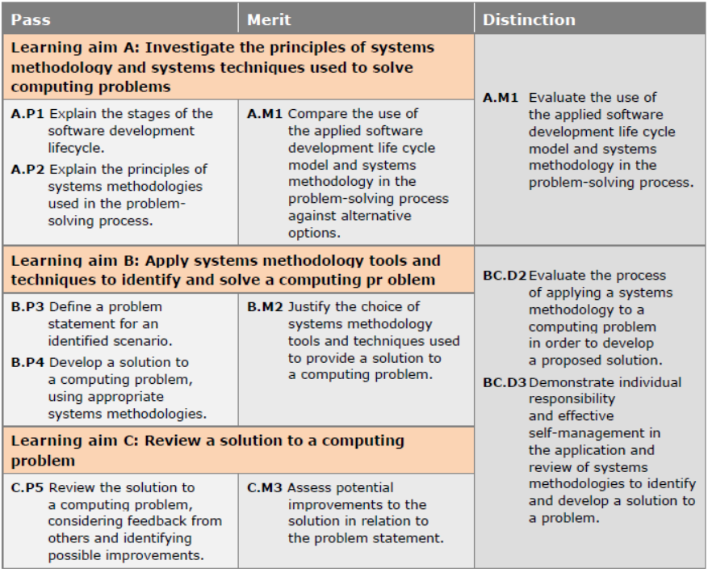
Unit 23
Systems Methodology
(Unit Grading)

Slide 5
Unit 23
Systems Methodology
Learning aims
In this unit you will:
Investigate the principles of systems methodology and systems techniques used to solve computing problems
Apply systems methodology tools and techniques to identify and solve a computing problem
Review a solution to a computing problem.

Slide 6
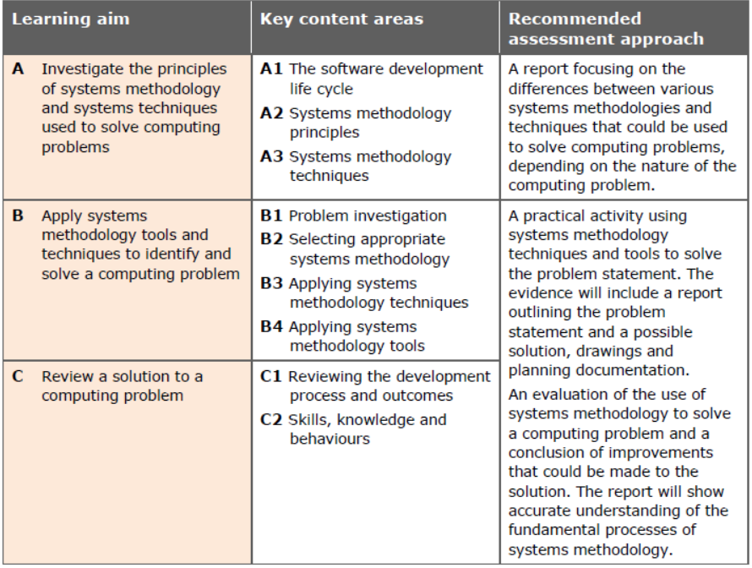
Unit 23
Systems Methodology
(Unit Summary)

